Slide 1
Anomaly Detection for Discrete Sequences: A Survey
Jorfun

Slide 2
目录
相关背景知识
离散序列异常检测的三类问题
解决三类问题的相关技术
Sequence-Based Anomaly Detection中的四类技术

Slide 3

About Discrete Sequences
user command sequences

Slide 4
About Discrete Sequences
A sequence is an ordered series of events. Sequences can be of different types, such as binary, discrete, and continuous, depending on the type of events that form the sequences. Discrete and continuous sequences (or time series) are two most important form of sequences encountered in real life applications.
Discrete or symbolic sequences are ordered sets of events such that the events are symbols belonging to a finite alphabet. For example, a text document is a sequence of words, a computer program is executed as a sequence of system calls, and a gene is a sequence of nucleic acids.

Slide 5
目录
相关背景知识
离散序列异常检测的三类问题
解决三类问题的相关技术
Sequence-Based Anomaly Detection中的四类技术

Slide 6
Three formulations of the sequence anomaly detection problem (1)
For the first formulation (SEQUENCE-BASED ANOMALY DETECTION), an entire sequence is anomalous if it is significantly different from normal sequences.
针对何为normal sequences？产生两个不同的定义

Slide 7
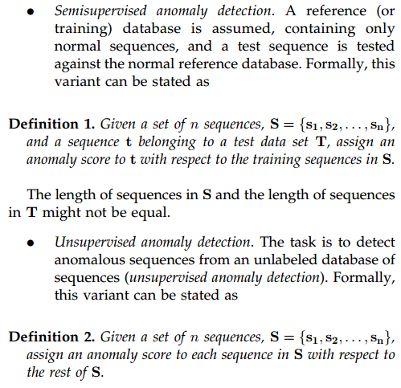

Slide 8
Three formulations of the sequence anomaly detection problem (2)
For the second formulation (CONTIGUOUS SUBSEQUENCE-BASED ANOMALY DETECTION), a contiguous subsequence within a long sequence is anomalous if it is significantly different from other subsequences in the same sequence.

Slide 9
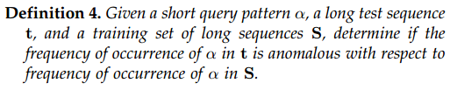
Three formulations of the sequence anomaly detection problem (3)
For the third formulation (PATTERN FREQUENCY-BASED ANOMALY DETECTION), a given test pattern is anomalous if its frequency of occurrence in a test sequence is significantly different from its expected frequency in a normal sequence. (pattern -> 用户指定的subsequence)

Slide 10
目录
相关背景知识
离散序列异常检测的三类问题
解决三类问题的相关技术
Sequence-Based Anomaly Detection中的四类技术

Slide 11
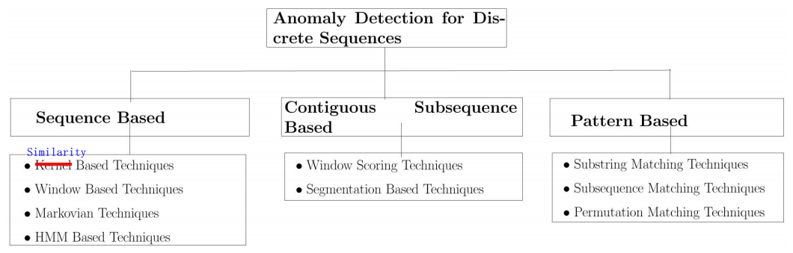
Categorization of existing anomaly detection research for discrete sequences

Slide 12


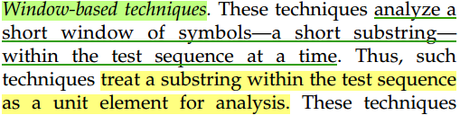
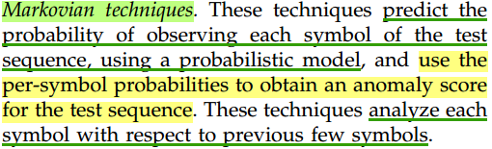
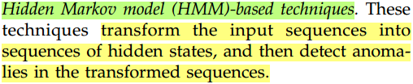
Sequence-Based Techniques

Slide 13
Continuous Subsequence-Based Anomaly Detection
Techniques in this category try to identify anomalous contiguous subsequences (or substrings) of a long sequence.
Basic technique: First, all k-length windows are extracted from the given sequence t and stored as a database of fixed-length windows, denoted as Tk. Each window is assigned an anomaly score by comparing it with rest of the windows in Tk, e.g., computing average distance of the window to the windows in Tk. The windows with anomaly scores above a user defined threshold are chosen as the top discords.

Slide 14
Pattern Frequency-Based Anomaly Detection
“if the frequency of the pattern differs substantially from that expected by chance, given some previously seen data.”
Basic technique: Assigns an anomaly score to the query pattern, α, as the difference between the frequency of occurrence of α in the sequence t and the average frequency of occurrence of α in the sequences in set S.

Slide 15
目录
相关背景知识
离散序列异常检测的三类问题
解决三类问题的相关技术
Sequence-Based Anomaly Detection中的四类技术

Slide 16
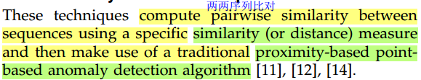
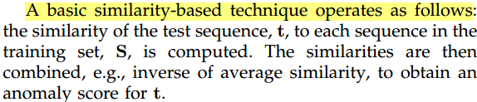
Similarity-Based Techniques
1. 先挑一个similarity measure计算出所有序列两两比对的相似性。
2. 然后使用point-based anomaly detection algorithm把每段序列当作独立的数据对象，从中寻找离群点。

Slide 17
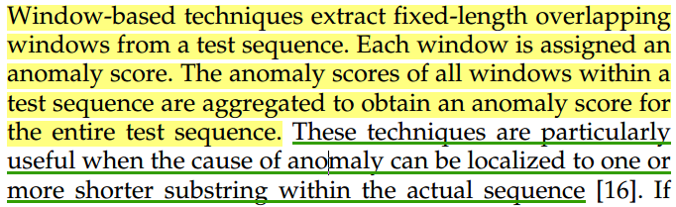
Window-Based Techniques

Slide 18
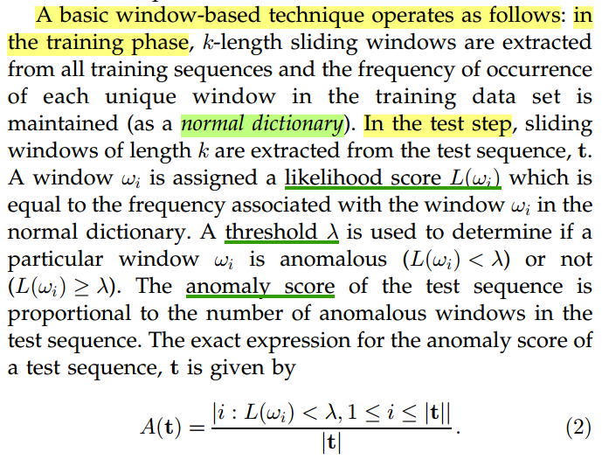

Slide 19
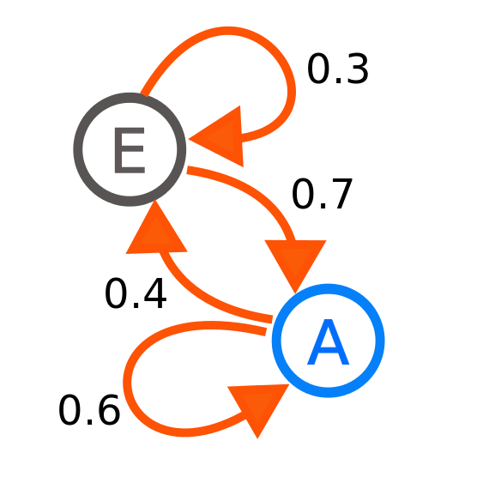
Markovian Techniques
Markov process is a stochastic process that satisfies the Markov property.
The probability distribution of the next state depends only on the current state and not on the sequence of events that preceded it. This specific kind of "memorylessness" is called the Markov property.

Slide 20
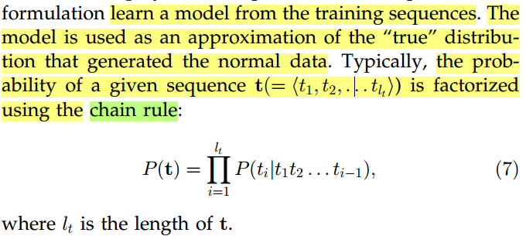
Markovian Techniques

Slide 21
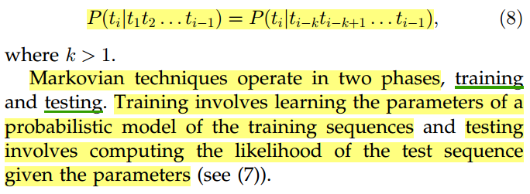
Markovian Techniques
Short Memory Property

Slide 22
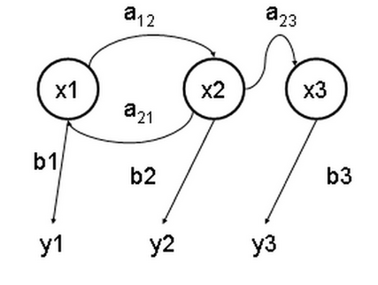
Hidden Markov Models-Based Techniques
x — 隐含状态 y — 可观察的输出 a — 转换概率 b — 输出概率

Slide 23
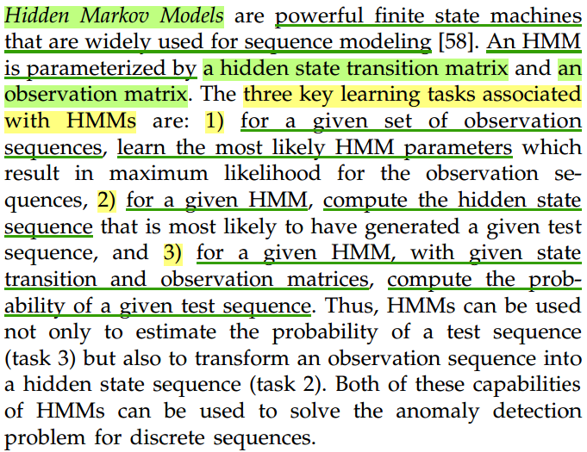
Hidden Markov Models-Based Techniques

